Slide 1
Health Information Modeling WG
March 10, 2015

Slide 2
AGENDA
Welcome and Roll Call
Terminology Modeling Update
FHIM Support for FHIR Update
CCDA to FHIM Mapping Results
Review of Vital Signs Domain Prior to Distribution to Federal Partners for Review/Validation (Tentative)
Wrap-up, Review of Action Items
2

Slide 3
Overview of FHIM Mapping/Validation Process -1
Ensure FHIM meets information exchange requirements
Federal partners – direct participation
S&I Framework Initiatives
Analysis of HL7 FHIR profiles/implementation guides for:
Data Access Framework (DAF)
Clinical Quality Framework (CQF)
Structured Data Capture (SDC)
Completed so far mapping to: LRI, LOI, DS4P, CI, LCC, PD. QH, TOC
Under way:
eLTSS (FHIM Care Plan modeling),
DPROV,
PDMP

Slide 4
Overview of FHIM Mapping/Validation Process - 2
Ensure FHIM meets information exchange requirements
Interoperability Standards provide broad guidelines:
HL7 Version 2
HL Version 3
HL7 CDA R2
Meaningful Use Requirements and associated implementation guides
Consolidated CDA
Release 1.1
Release 2.0
New template versions

Slide 5
FHIM Validation Update: MU2 and C-CDA
Meaningful Use Stage 2/2014 requirements
Data requirements
Terminology
SNOME-CT, LOINC, UCUM, RxNorm, CPT-4
Templates
Constraints applied to the CDA R2 documents, sections, and entries
Testable constraints intended to support MU2
SHALL
SHOULD
Vocabulary constraints
Value Set bindings (STATIC, DYNAMIC keywords)

Slide 6
Mapping Summary
Added an additional context code for diagnosis to support 6 templates using the current FHIM Diagnosis class:
"59769-0" Post-procedure diagnosis
"11535-2" Hospital discharge diagnosis
"46241-6" Admission diagnosis
"29308-4" Diagnosis (Encounter Diagnosis template)
"10219-4" Preoperative Diagnosis
"10218-6" Postoperative Diagnosis

Slide 7
HL7 Fast Health Interoperable Resources (FHIR) Content Validation/Analysis

Slide 8
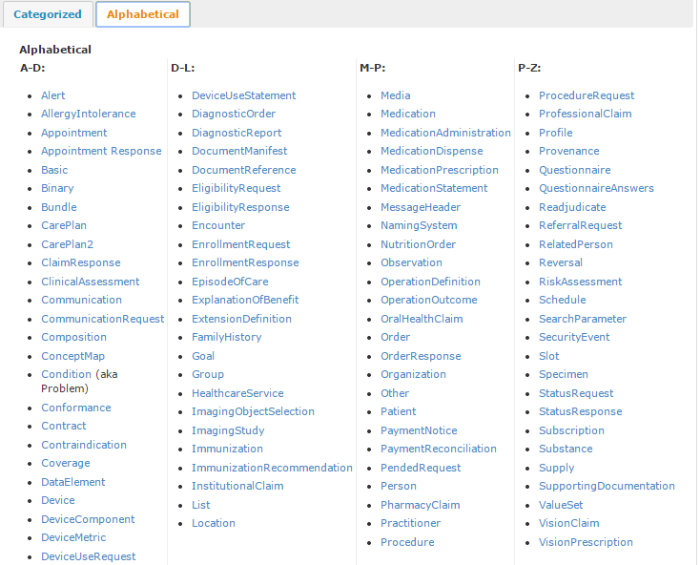
FHIR Resources

Slide 9
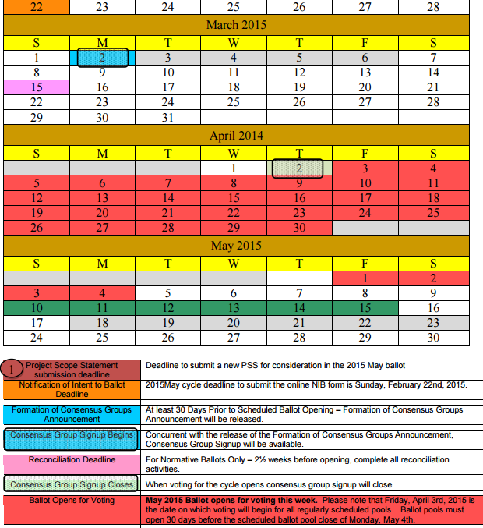
FHIR DSTU Ballot

Slide 10
FHIR DSTU Ballot…continued
Ballot signup
Closes 4/2
Review
Starts 4/3
Ends 5/4
Ballot reconciliation
Starts at the HL7 WMG

Slide 11
FHIM2FHIR Transformation Update -1
Extend HAPI FHIR implementation
Initial solution to extend HAPI is underway to support a UML to HAPI transformation.
Initially auto-generate profiles as XSL as input to HAPI FHIR API (Java)
Eventually XML will be auto-generated from FHIM
Incorporate FHIR Terminology extensions
The expected terminology extensions have fallen short of expectations limiting our ability to start working on this functionality.
We will instead start to focus on generating the FHIR extensions from FHIM classes

Slide 12
FHIM2FHIR Transformation Update -2
Generate from FHIM conformance and coded models
FHIR resources allow extensions
FHIM can provide detailed definitions for extensions shared by US and Federal partners
Publish FHIR resource artifacts for a Use case exchange defined in the FHIM
Currently planning to use the FHIM to model the Vital Signs and generate the corresponding FHIR profiles (including extension, if needed).

Slide 13

FHIM2FHIR Transformation Update -3
Microsoft .NET Support - The FHIR Management group has developed a series of solutions supporting FHIR for the .NET platform (https://github.com/ewoutkramer/fhir-net-api)
The current solution takes in a FHIR profile XML (conforming to the FHIR profile XSD) rather than the equivalent spreadsheet
We hope to leverage the tooling to provide a .NET solution for the FHIM exchanges.
Leverage Microsoft RESTful service support for resource retrieval and persistence

Slide 14
Straw Poll 1: FHIR Implementation Planning
In order to better understand general FHIR usage, we would appreciate if everyone to could participate in a straw poll on your agencies plans for FHIR:
Already implementing FHIR
We plan on implementing FHIR
We will start in the next 12 months
We will start 1 to years
We have no plans but do expect to use FHIR
We will not leverage FHIR for the foreseeable future

Slide 15
Straw poll 2: FHIR Implementation Needs
As part of our FHIR implementation we plan to do the following:
Use existing FHIR resources and profiles “as is”
Develop new FHIR resource definitions
Develop additional FHIR profiles
Constrain existing FHIR resources
Extend existing FHIR resources

Slide 16
Straw poll 3: Implementation Platform and Collaboration
We will use the following technologies for FHIR:
Java/Apache
Microsoft.NET
As part of our FHIR implementation we are:
Interested in collaborating to develop share FHIR solutions
Open source
Reference implementation
Not interested in collaborating

